Slide 1


Giovanni BRICCONI
Dec 27 2023

Slide 2

Outline
Executive Summary
Introduction
Methodology
Results
Conclusion
Appendix

Slide 3
Executive Summary
Summary of methodologies
Public data and web scraping / data cleaning pandas and SQL / data visualization and online dashboards with Folium and Dash / data visualization with matplotlib / how to predict successful returns using different algorithms
Publicly available data allows to understand key points on SpaceX business
Where launch sites should be located
How launch reliability has improved during these years
Kind of payload launched and rocket recovery success rate

Slide 4
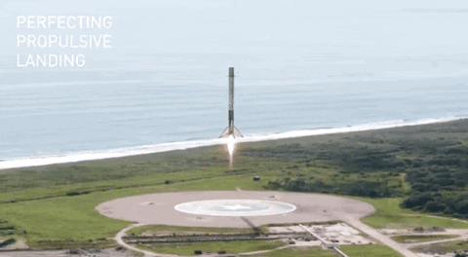
Introduction
SpaceX advertises Falcon 9 rocket launches with a cost of 62 million dollars; other providers cost upward of 165 million dollars each
Much of the savings is because SpaceX can reuse the first stage.
Cans SpaceY understand when first stage reusage is possible and gain precious insights on how to orient its business?
Which are the most effective launch sites?
Which kind of payloads and orbit offer the best opportunities?

Slide 5

Section 1

Slide 6
Methodology
Executive Summary
Data collection methodology:
Calls to web services endpoints. Scraping of Wikipedia pages with BeautifulSoup
Perform data wrangling
NaN values handling, outcomes normalization
Perform exploratory data analysis (EDA) using visualization and SQL
Perform interactive visual analytics using Folium and Plotly Dash
Perform predictive analysis using classification models
Train test data splitting, hyperparameters tuning, data normalization, benchmark of LogisticRegression, SupportVectorMachines, DecisonTrees and Kneighbors Classifier.

Slide 7
Data Collection
SpaceX public API used to get launch information (`pandas` and `requests` python libraries)
Filtering on Falcon 9 launches
Mean values used to substitute NaN values
Wikipedia scraping with BeautifulSoup lib

Slide 8
Data Collection – SpaceX API
First collect data from launches.
Collect extendend information from other APIs
Detect missing values and use average payload weights as replacement
GitHub code
Rest call https://api.spacexdata.com/v4/launches/past
Json normalize
Get extended data from other APIs cores launchpad payloads and rockets
Dealing with missing PayloadWeights

Slide 9
Data Collection - Scraping
Wikipedia contains complementary information, but in HTML format.
Using BeautifulSoup to convert text data into a pandas dataframe
GitHub code
Python’s request lib to capture the text
BeautifulSoup to select the right table and convert raw text to clean data
Create a dataframe

Slide 10
Data Wrangling
Using Pandas to
Identify launch sites
analyze orbits kinds and frequencies
Analyze outcomes kinds -> we want to identify first stage recovery
GitHub link
Read data frame
Value counts on orbits and launch sites
Outcomes mapping

Slide 11
EDA with Data Visualization
Payload mass evolition wrt flight number
Lunches by launch sites
Payload vs Launch site
Success rate by orbit type
Orbit / payload relation
Success rate evolution during these years
GitHub code

Slide 12
EDA with SQL
View launces from CCA
Total payload lanched from NASA CRS
F9 v1.1 average payload
Discover first ground pad successful outcome
Date processing with sqlite
Could just take pictures of the notebook, save option was not working. See the Screenshot pictures in https://github.com/gibri/data-science-training/tree/master/spacex

Slide 13
Build an Interactive Map with Folium
Locate launch sites and launches on the maps using circles and explanatory markers. Draw distance lines from a specific point. Launch sites are near rail stations and far from cities.
GitHub URL

Slide 14
Build a Dashboard with Plotly Dash
Analyze success rate by launch site with pie chart
Filter on payload weight
Show scatter plot representing launches outcome
Which site has the largest successful launches? KSK lc-39A
Which site has the highest launch success rate? KSK lc-39A
Which payload range(s) has the highest launch success rate? 2/4k
Which payload range(s) has the lowest launch success rate? 6/10k
Which F9 Booster version (v1.0, v1.1, FT, B4, B5, etc.) has the highest launch success rate? FT
Explain why you added those plots and interactions
GitHub URL

Slide 15
Predictive Analysis (Classification)
Input data has been normalized and divided into test and train sets (20%-80%)
Four models have been compared: SVM, Decision Trees, logistic regression and Knearest neighbors
Hyperparameter tuning cross validation 10 folds
Performances compared using confusion matrixes, and correct scores on test data
KNN is the best model
https://github.com/gibri/data-science-training/blob/master/spacex/SpaceX_Machine_Learning_Prediction_Part_5.jupyterlite.ipynb

Slide 16
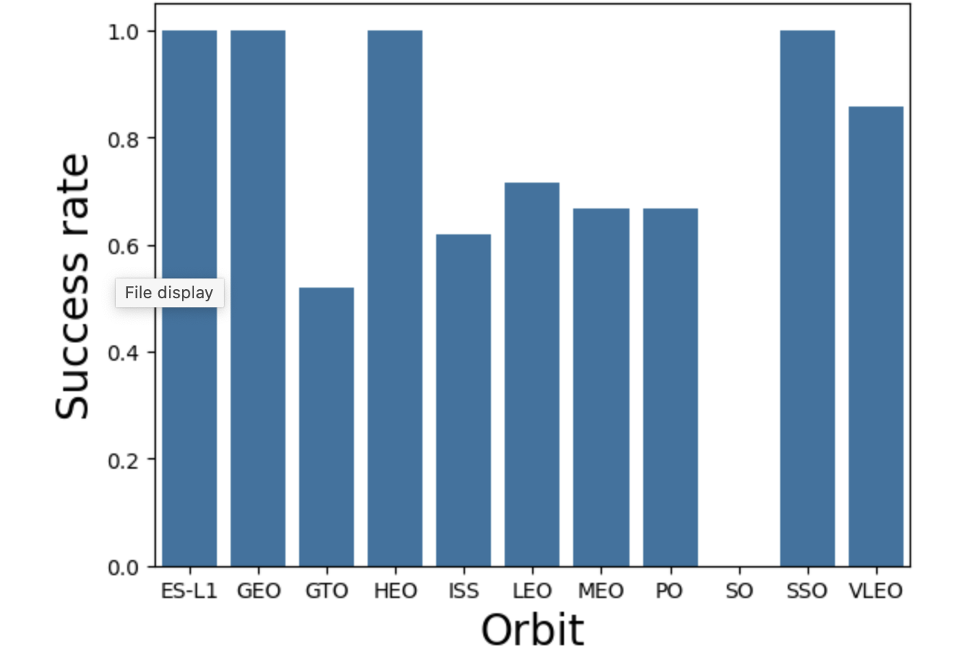
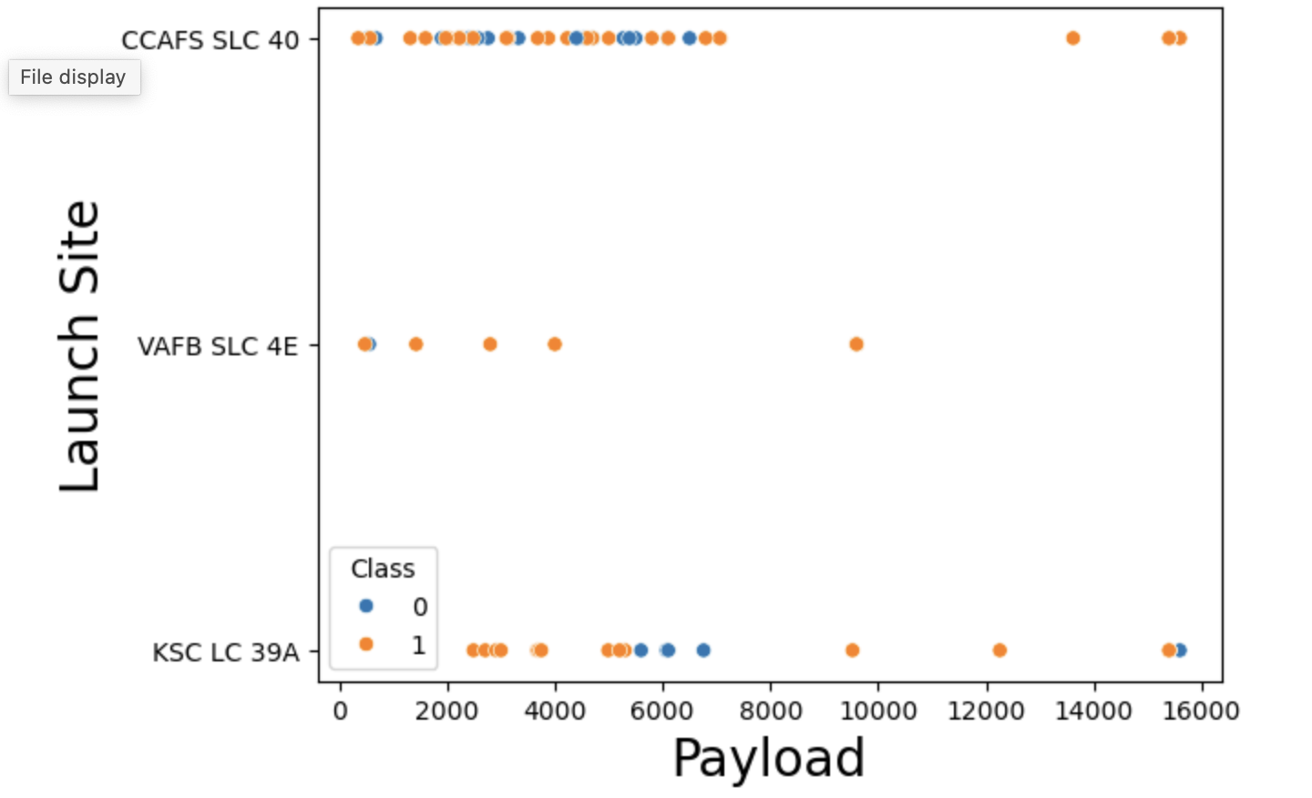
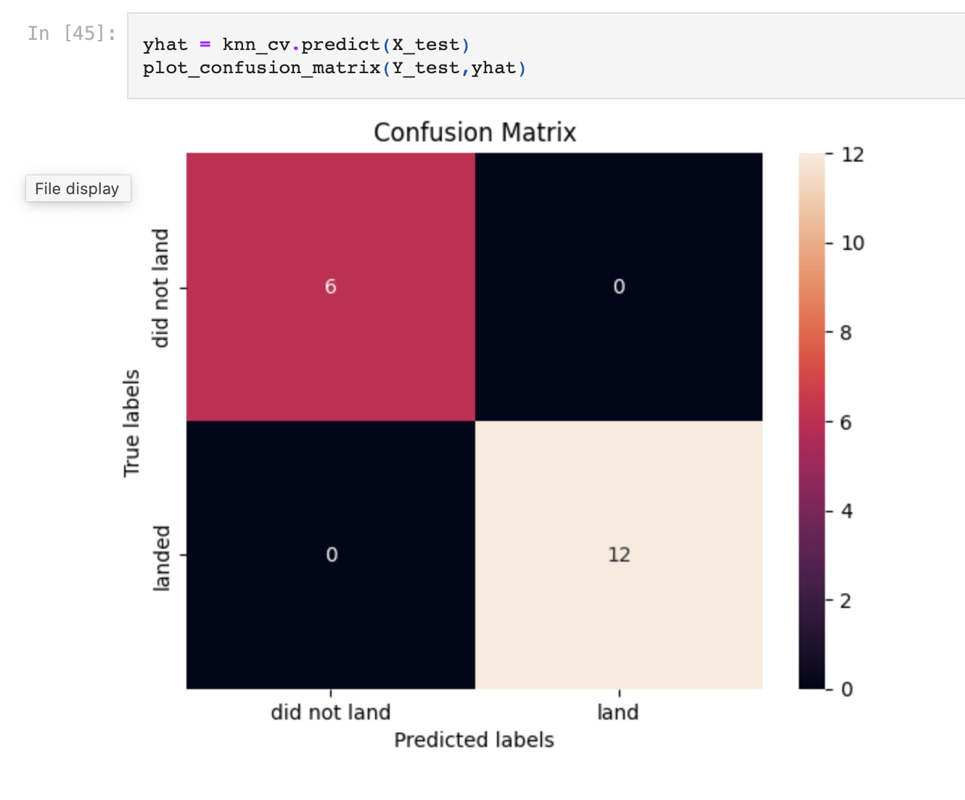
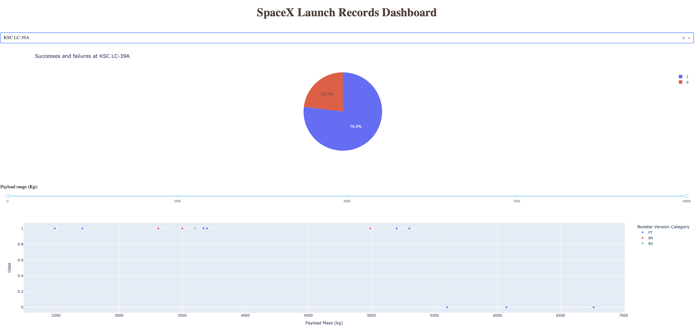
Results knn is the best model

Slide 17

Section 2

Slide 18
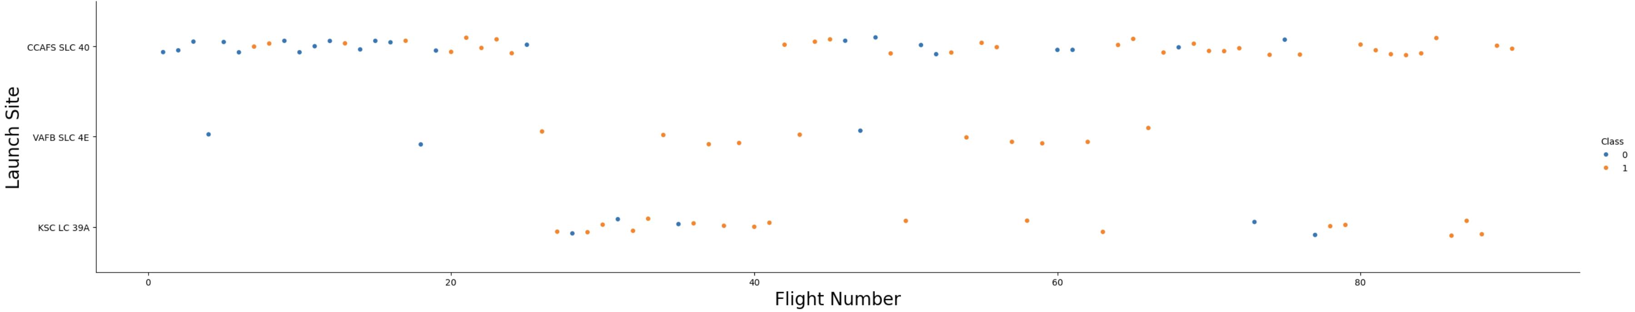
Flight Number vs. Launch Site
Flight Number vs. Launch Site. SpaceX operates mainly from 2 sites, but a third one was used too. Orange dots represent successful return of the 1st stage. New launches are usually successful.

Slide 19
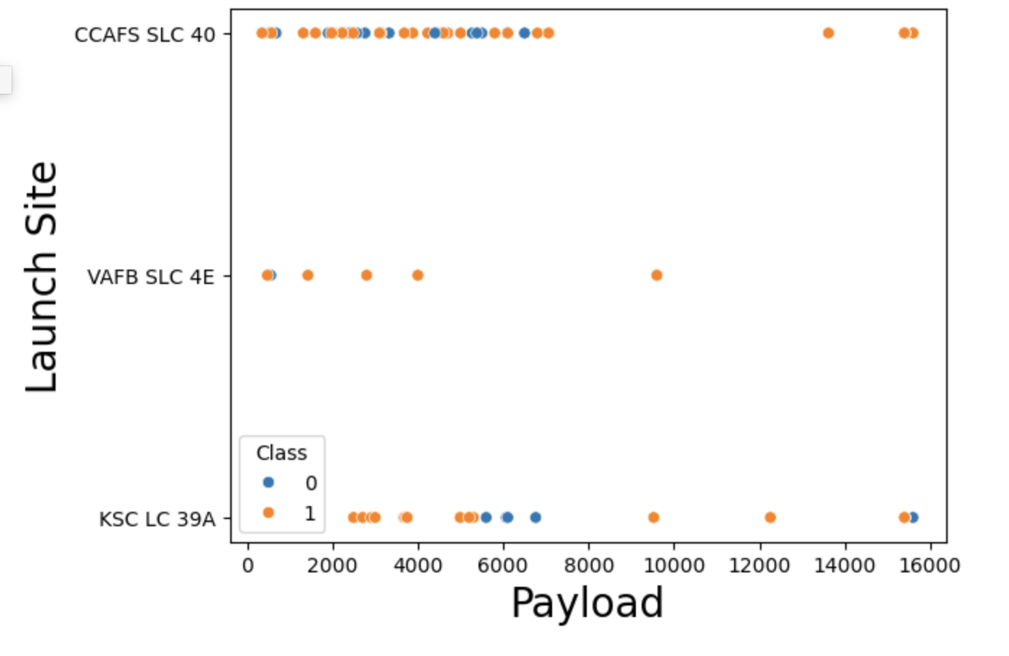
Payload vs. Launch Site
VAFB site launch only light payload missiles.
The other 2 sites are more versatile

Slide 20
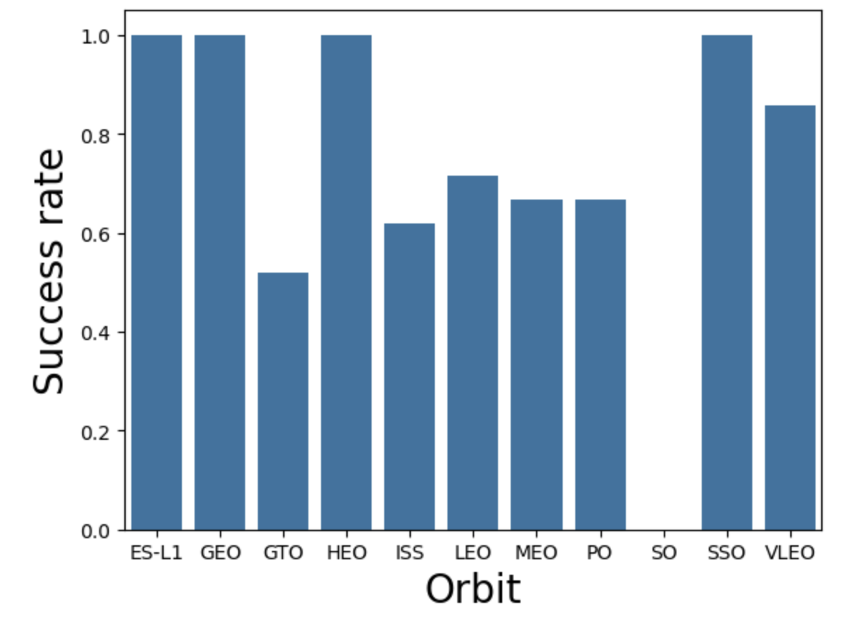
Success Rate vs. Orbit Type
It’s possible to launch satellites with 11 different orbit types.
The success rate depends on the orbit type

Slide 21
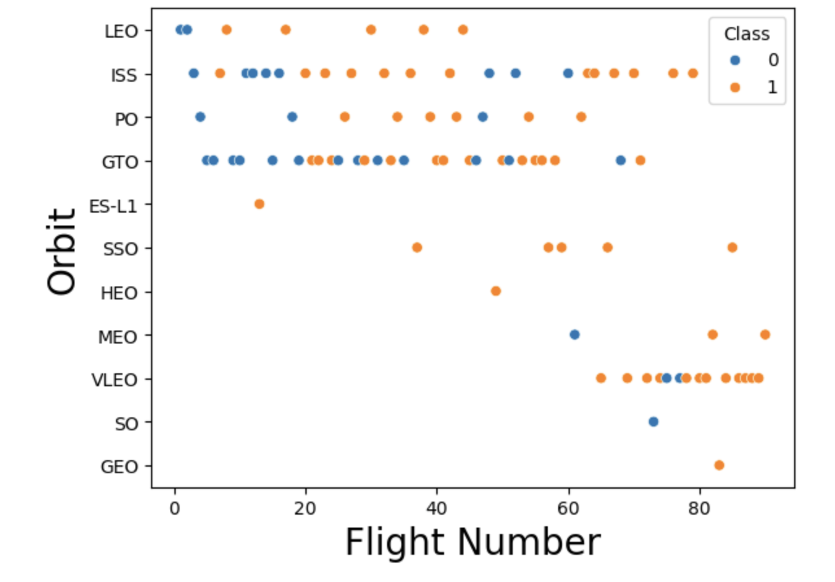
Flight Number vs. Orbit Type
Recently VLEO orbit stated to be very used for new launches.
In the LEO orbit the Success appears related to the number of flights

Slide 22
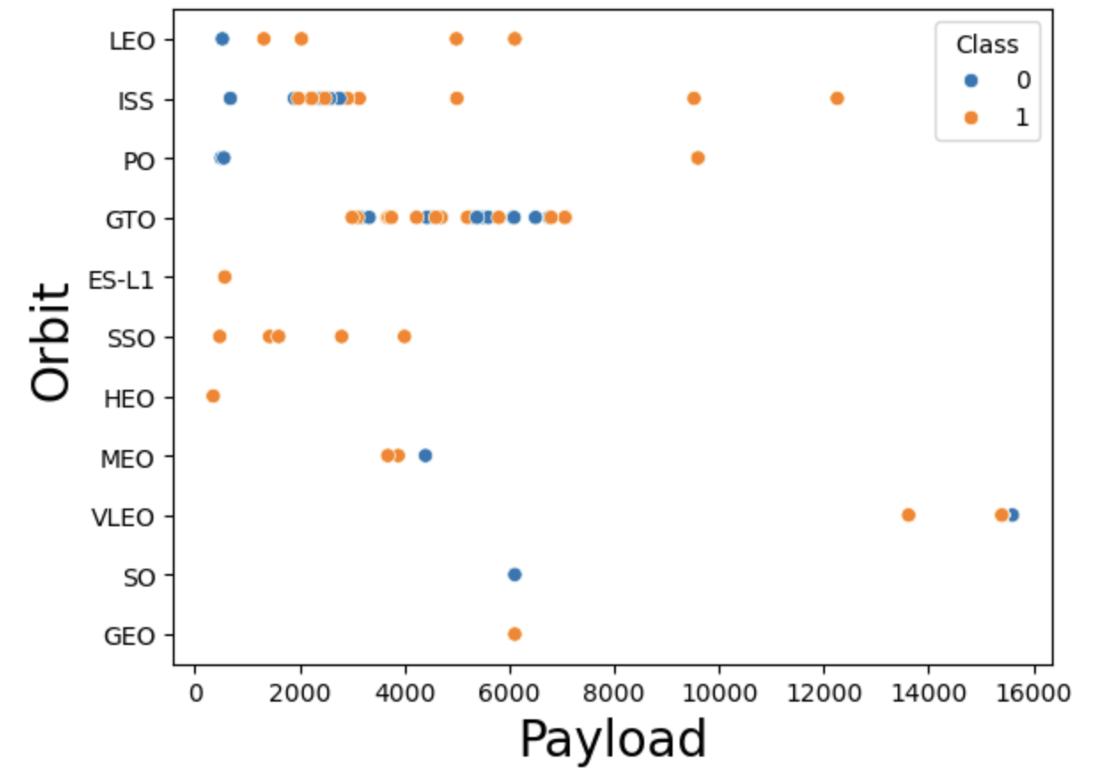
Payload vs. Orbit Type
With heavy payloads the successful landing or positive landing rate are more for Polar,LEO and ISS.
However for GTO we cannot distinguish this well as both positive landing rate and negative landing(unsuccessful mission) are both there here.

Slide 23
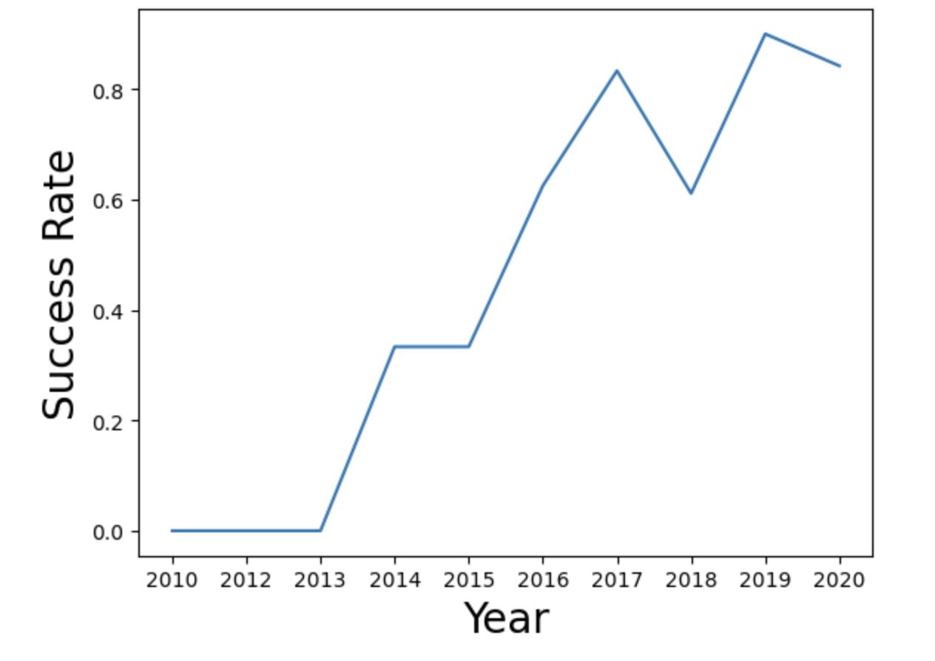
Launch Success Yearly Trend
Since 2013 the success rate started to increase

Slide 24
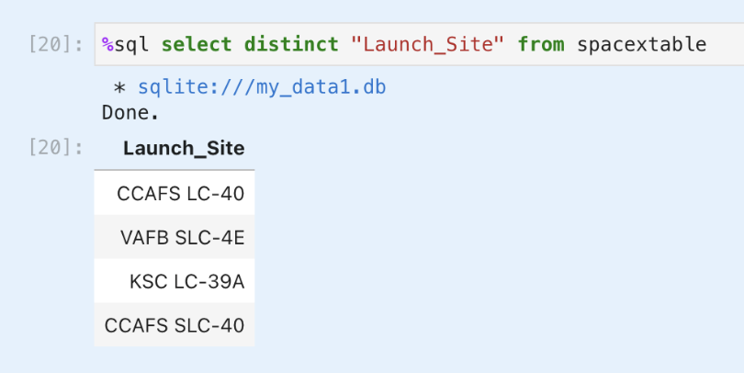
All Launch Site Names
We see that actually rockets are launched from 4 different sites, although 2 are in the same space center.

Slide 25
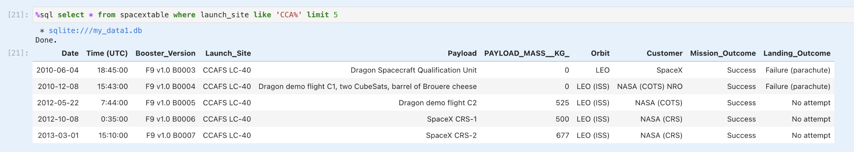
Launch Site Names Begin with 'CCA'
Some examples of launces from the `CCA` space center

Slide 26
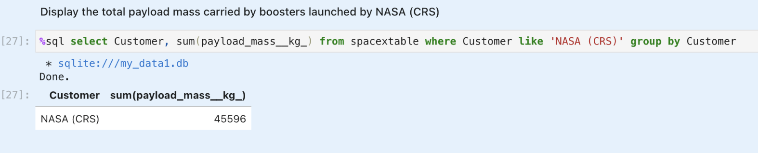
Total Payload Mass
The total payload carried by boosters from NASA is about 46,000 Kg

Slide 27
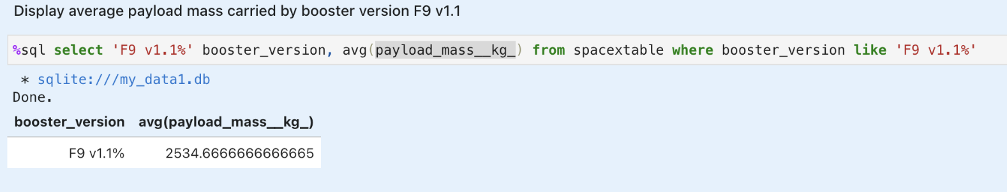
Average Payload Mass by F9 v1.1
The average payload mass carried by booster version F9 v1.1 is 2,500 Kg

Slide 28
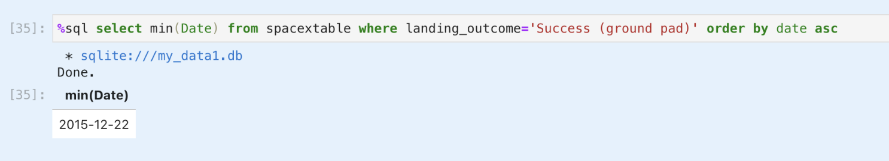
First Successful Ground Landing Date
The first successful landing outcome on ground pad happened in December 2015

Slide 29
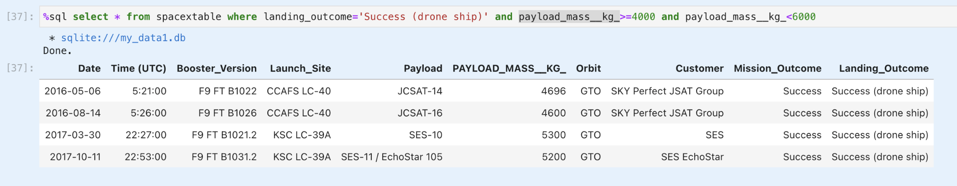
Successful Drone Ship Landing with Payload between 4000 and 6000
Rockets can land on a drone ship. Successfully landed on drone ship with payload mass greater than 4000 but less than 6000

Slide 30
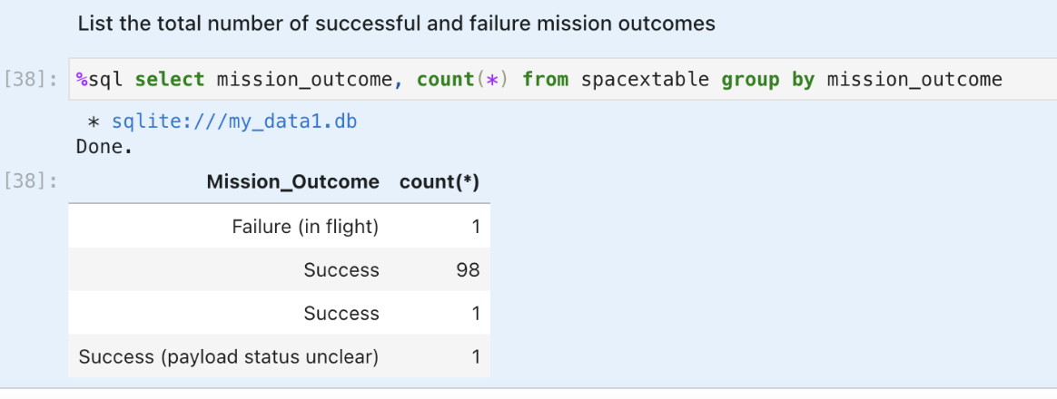
Total Number of Successful and Failure Mission Outcomes
Total number of successful and failure mission outcomes

Slide 31
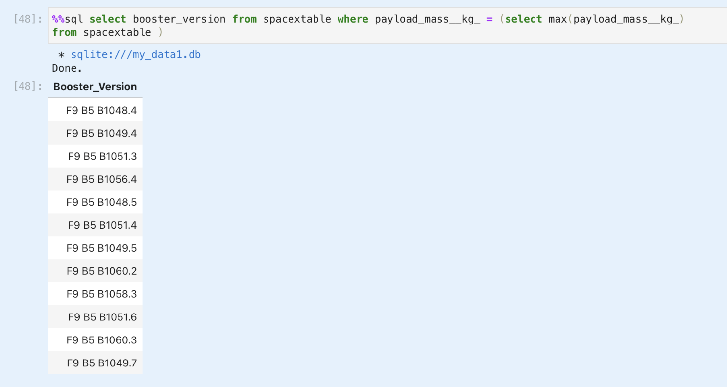
Boosters Carried Maximum Payload
The boosters which have carried the maximum payload mass

Slide 32
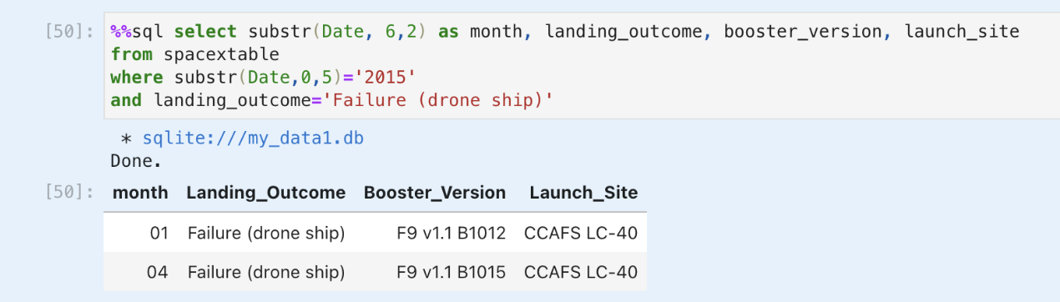
2015 Launch Records
The failed landing_outcomes in drone ship, their booster versions, and launch site names for in year 2015

Slide 33
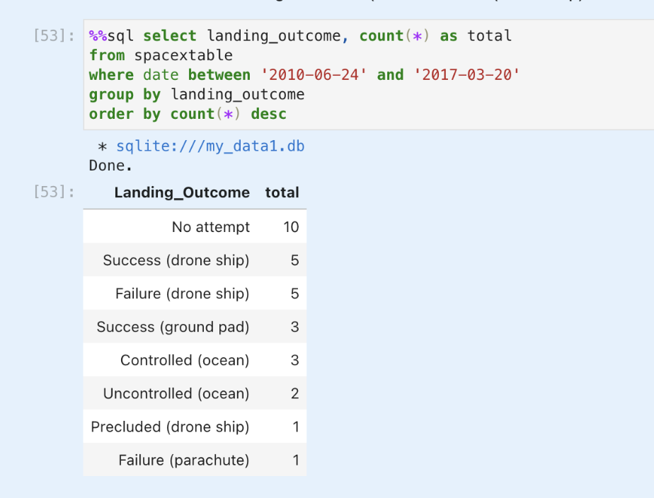
Rank Landing Outcomes Between 2010-06-04 and 2017-03-20
Count of landing outcomes (such as Failure (drone ship) or Success (ground pad)) between the date 2010-06-04 and 2017-03-20

Slide 34

Section 3

Slide 35
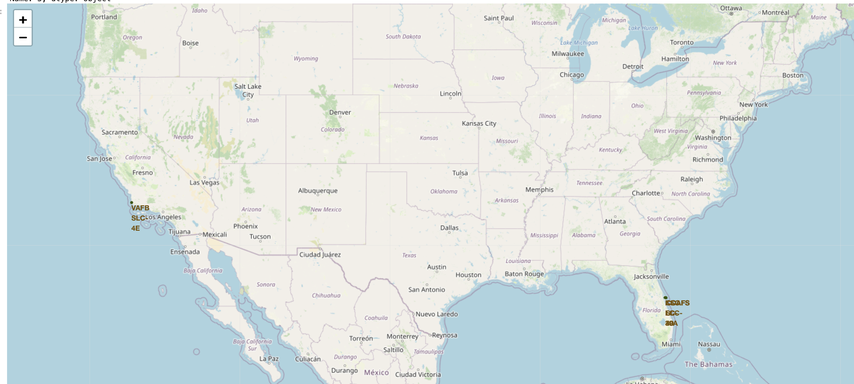
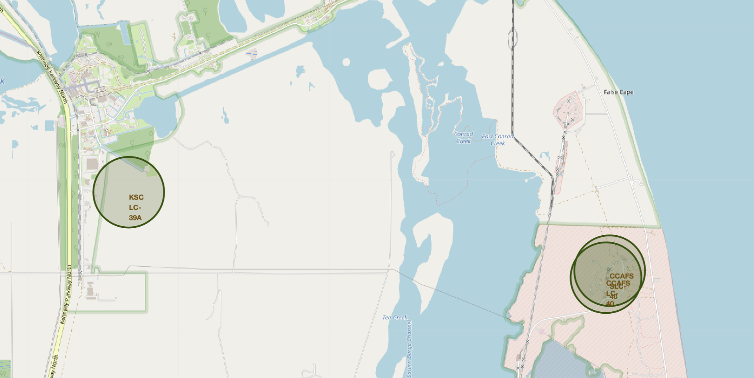
Launch site locations
SpaceX launches from the East and the West coast. Sites on the east coast are very close

Slide 36
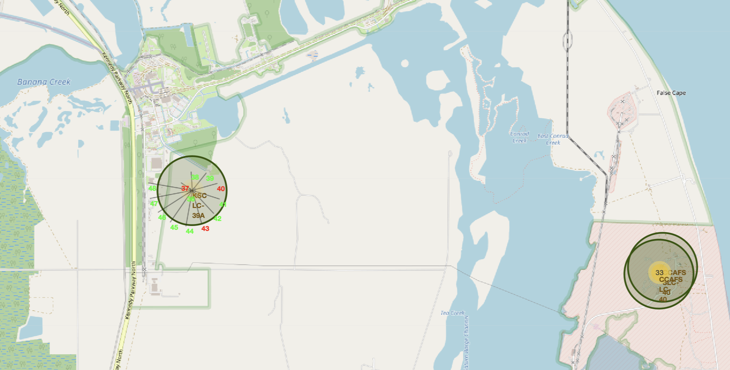
Successful launches by site
We can explore successful launches by site

Slide 37
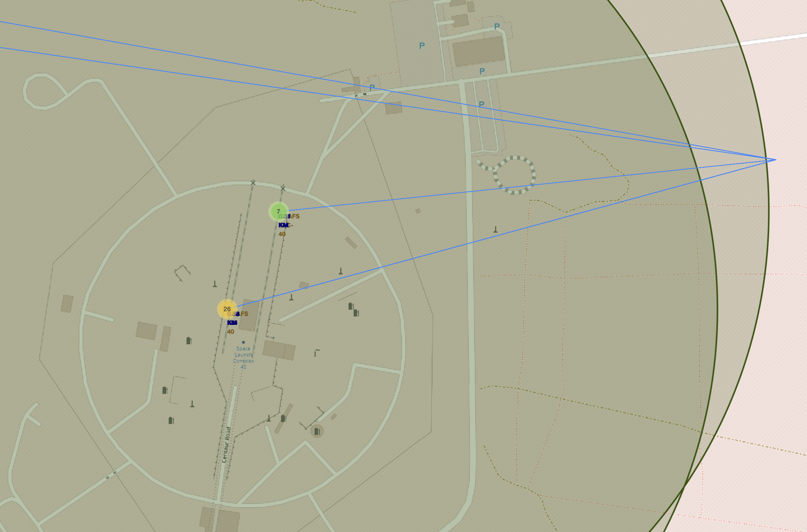
Launch sites are close to railroads
Highway and coastline are close, and cities are far away.

Slide 38

Section 4

Slide 39
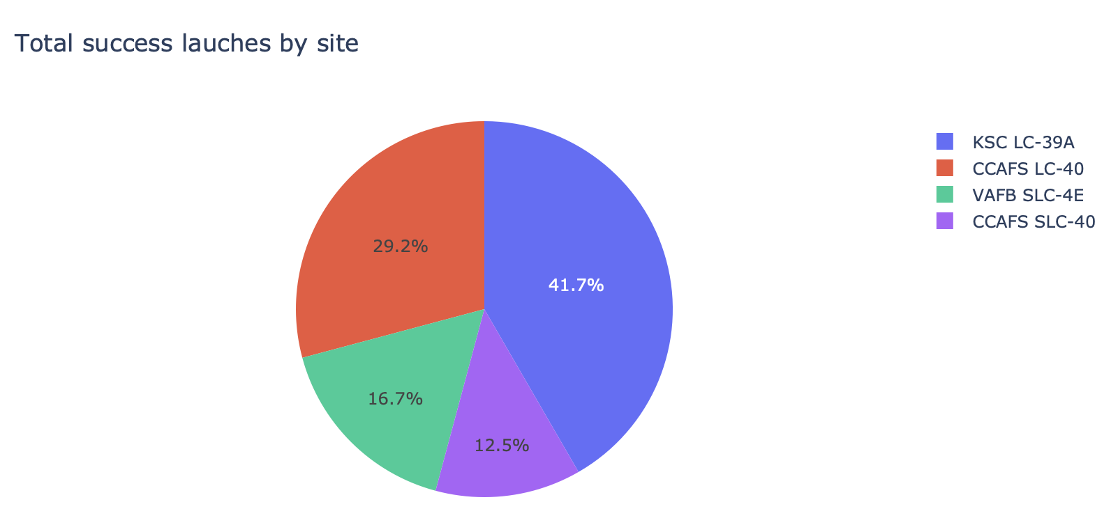
KSC is the most successful launch site

Slide 40
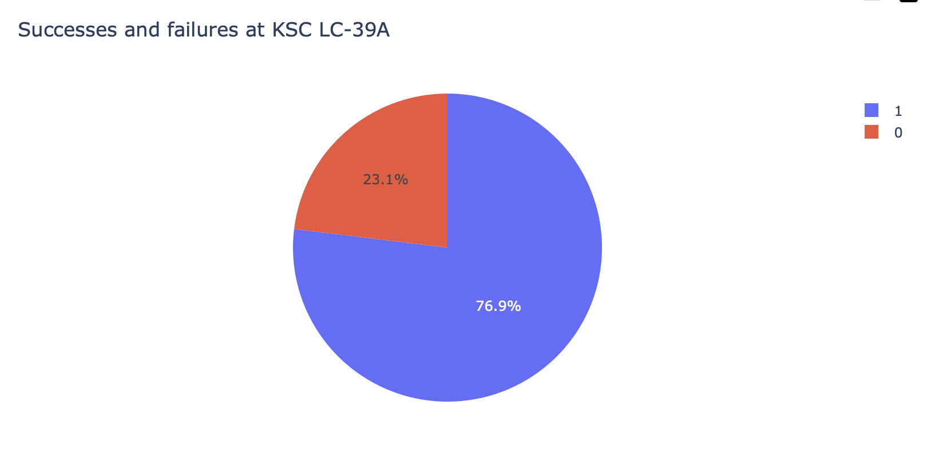
76% of launches are successful on KSC

Slide 41
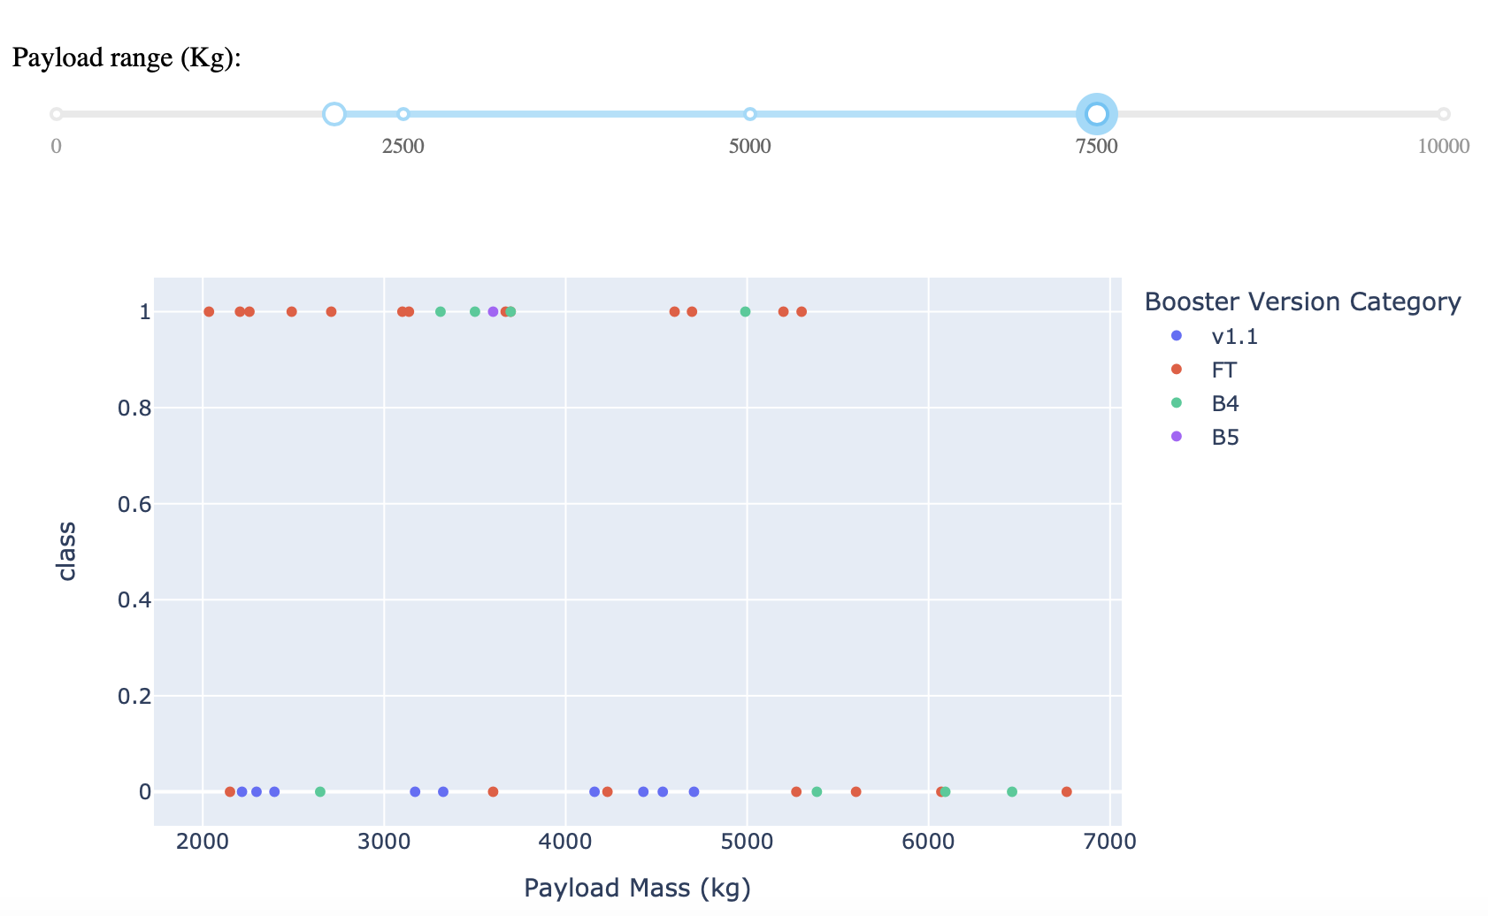
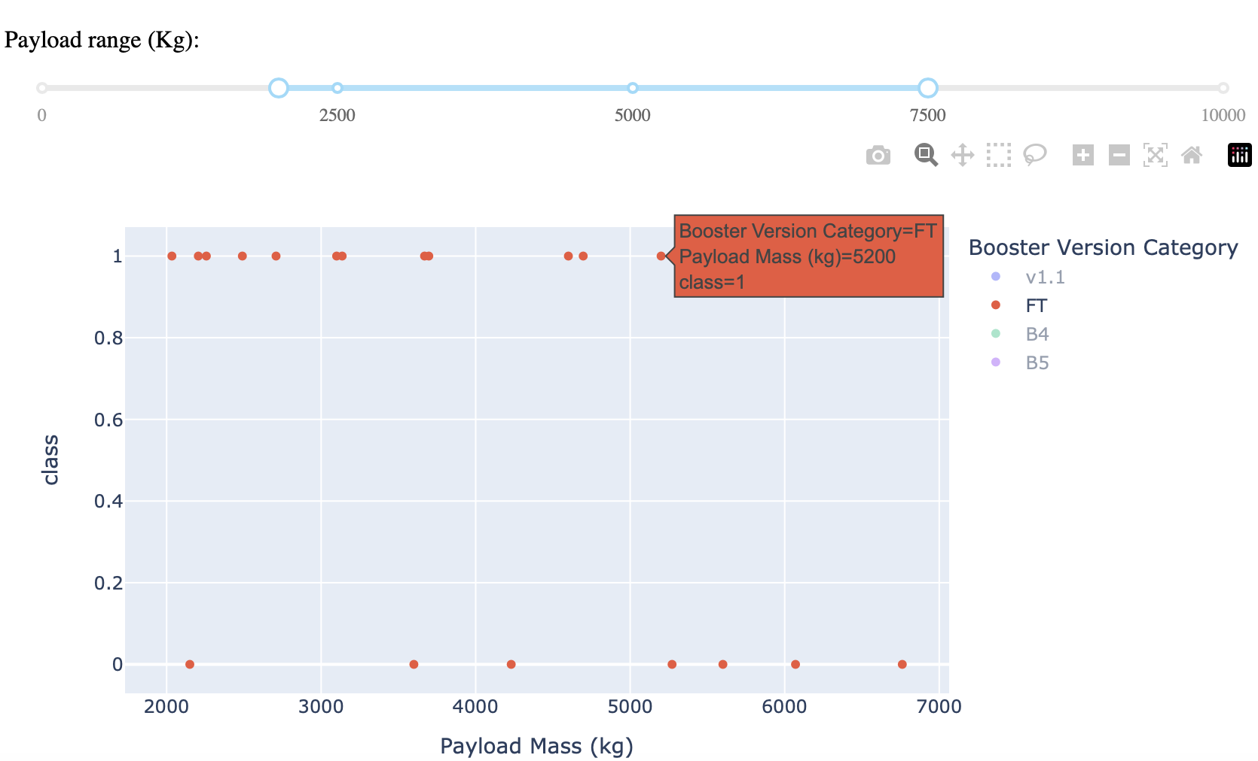
Success and failure on a payload range
FT boosters are the most effectives on this common payload range

Slide 42

Section 5

Slide 43
Classification Accuracy

Slide 44
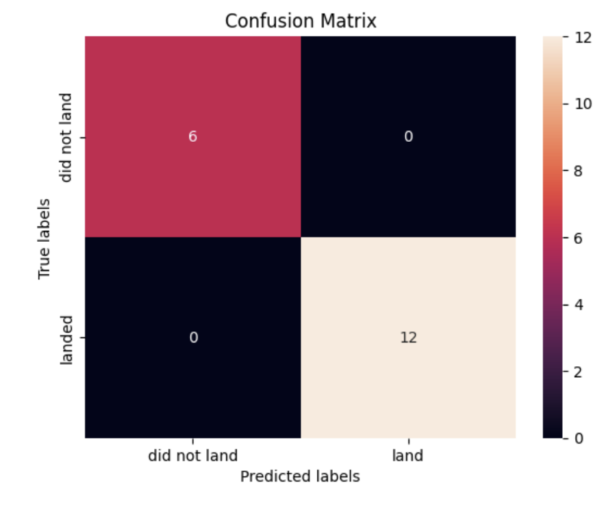
Confusion Matrix
KNN classifies always correctly the records in the test set.

Slide 45
Conclusions
Launch sites should be close to railways
It is possible to shoot satellites on many different types of orbits
We can predict a launch outcome using information on similar launches (knn).

Slide 46
Appendix
Include any relevant assets like Python code snippets, SQL queries, charts, Notebook outputs, or data sets that you may have created during this project

Slide 47


